Slide 1
HEAP sort

Slide 2
Introduction
Heap Sort is a popular and efficient sorting algorithm in computer programming.
Learning how to write the heap sort algorithm requires knowledge of two types of data structures - arrays and trees.

Slide 3
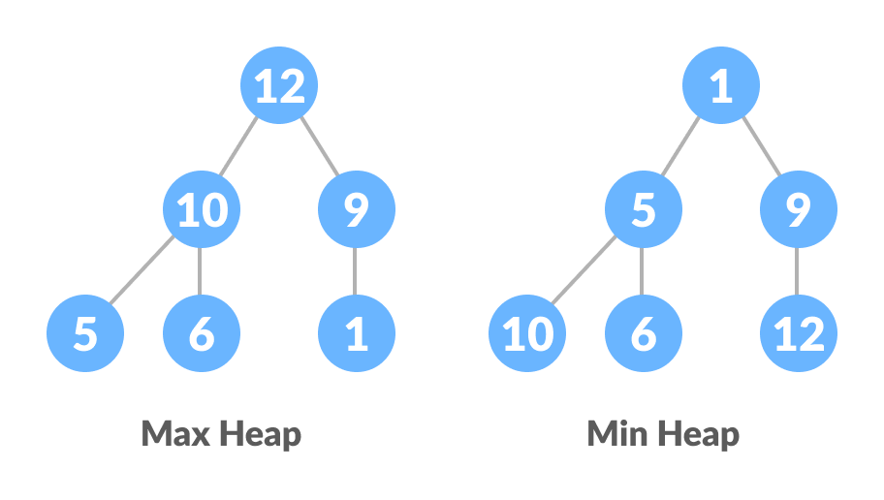
Heap Data Structure
Heap is a special tree-based data structure. A binary tree is said to follow a heap data structure if
it is a complete binary tree
All nodes in the tree follow the property that they are greater than their children i.e. the largest element is at the root and both its children and smaller than the root and so on. Such a heap is called a max-heap. If instead, all nodes are smaller than their children, it is called a min-heap

Slide 4
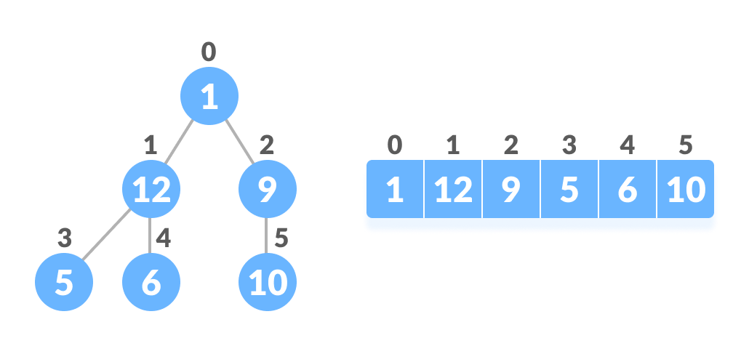
Relationship between Array Indexes and Tree Elements
A complete binary tree has an interesting property that we can use to find the children and parents of any node.
If the index of any element in the array is i,
element in the index 2i+1 will become the left child
element in 2i+2 index will become the right child.
Also, the parent of any element at index i is given by the lower bound of
(i-1)/2.

Slide 5
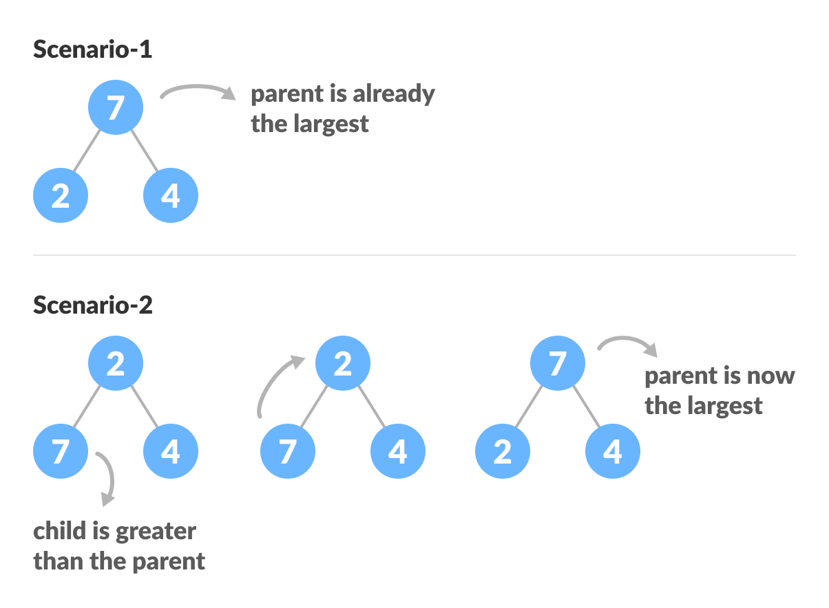
How to "heapify" a tree

Slide 6
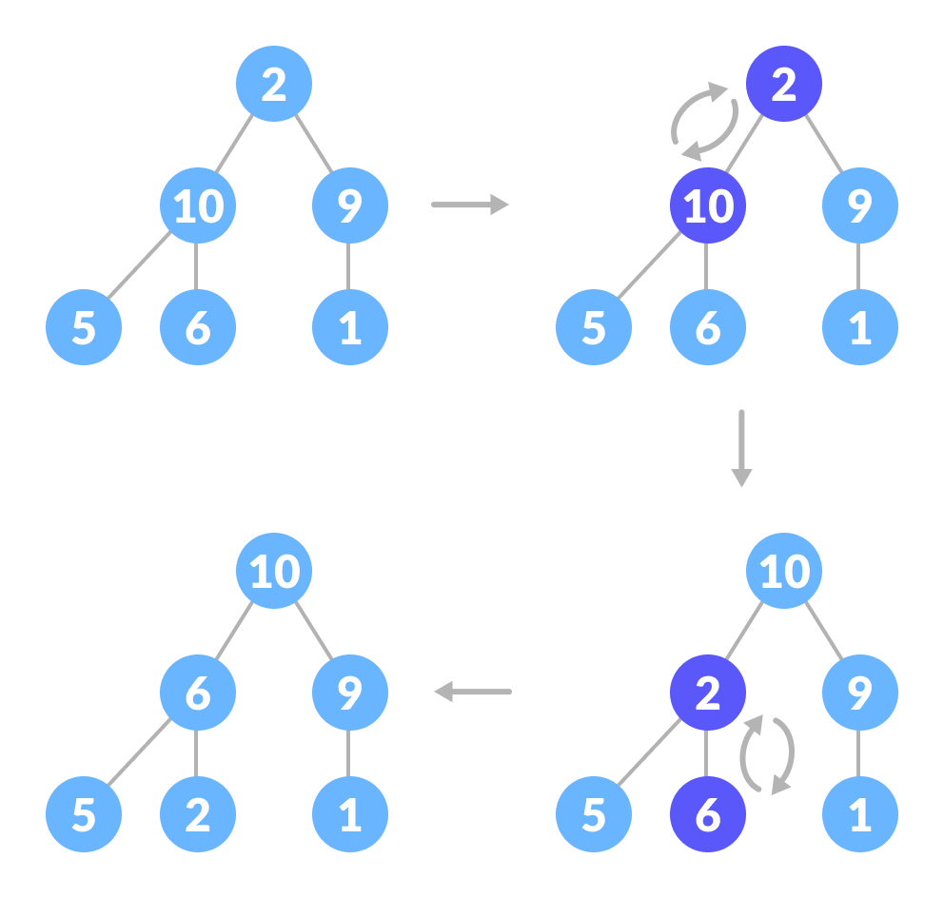
How to "heapify" a tree

Slide 7
Working of Heap Sort
Since the tree satisfies Max-Heap property, then the largest item is stored at the root node.
Swap: Remove the root element and put at the end of the array (nth position) Put the last item of the tree (heap) at the vacant place.
Remove: Reduce the size of the heap by 1.
Heapify: Heapify the root element again so that we have the highest element at root.
The process is repeated until all the items of the list are sorted.

Slide 8
implementation

Slide 9
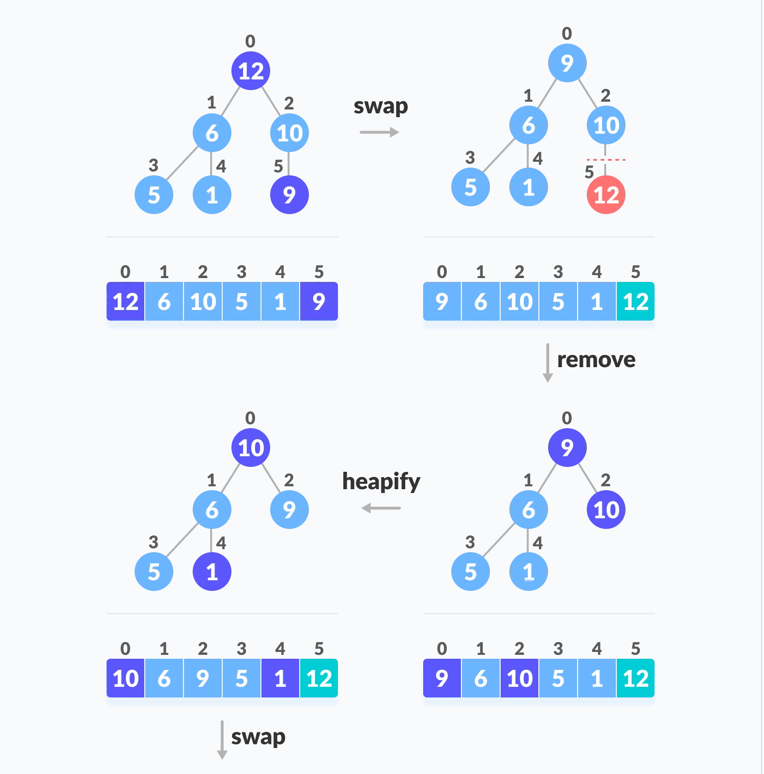
implementation

Slide 10
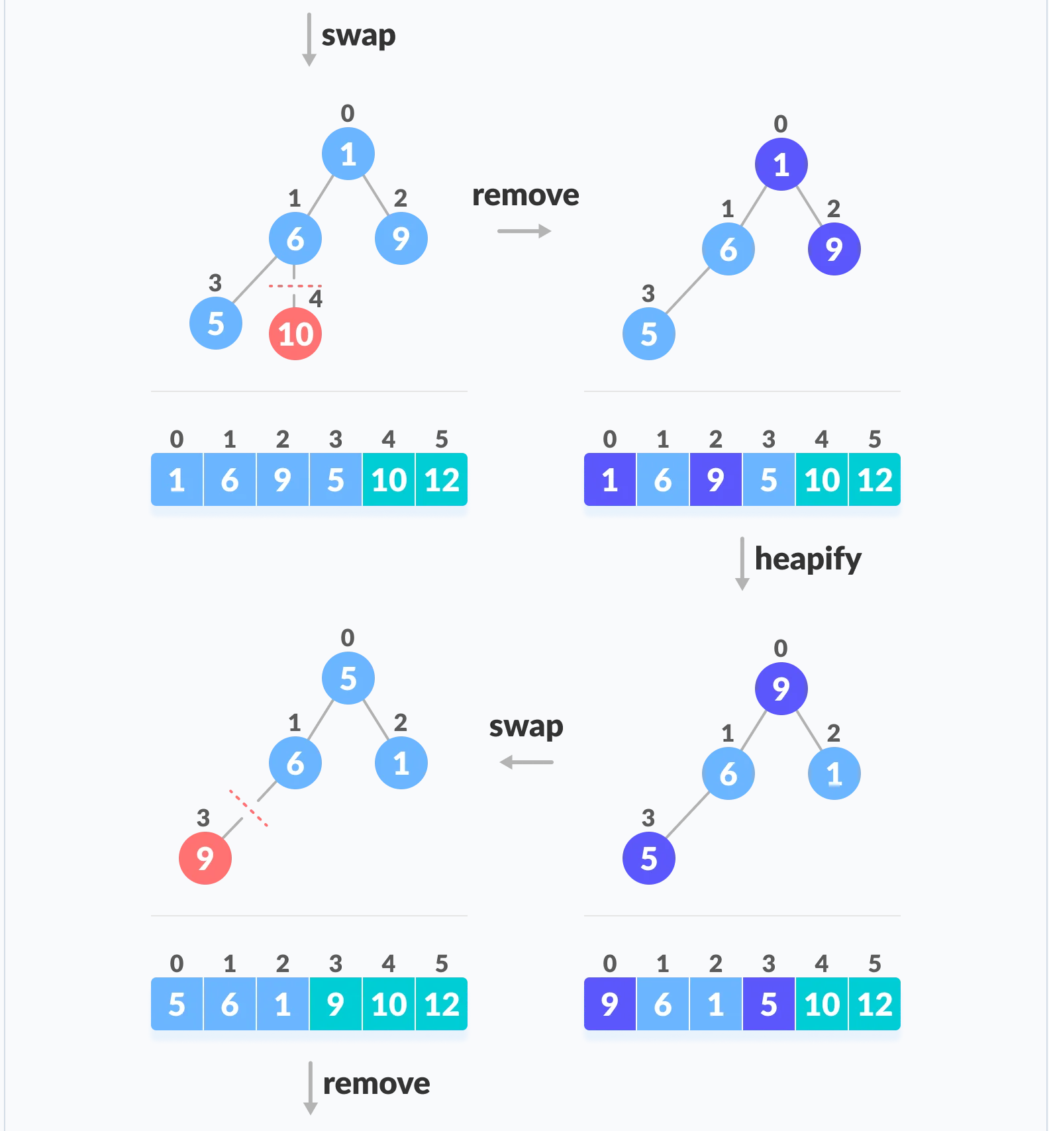
implementation

Slide 11
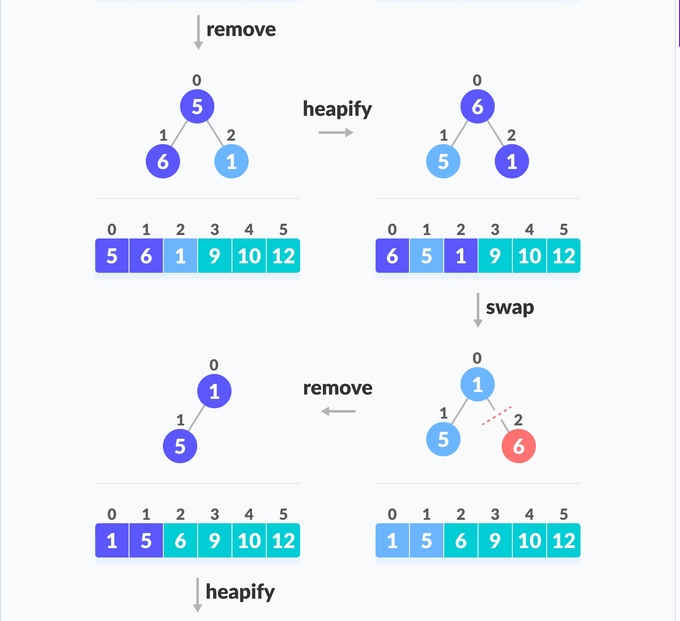
implementation

Slide 12
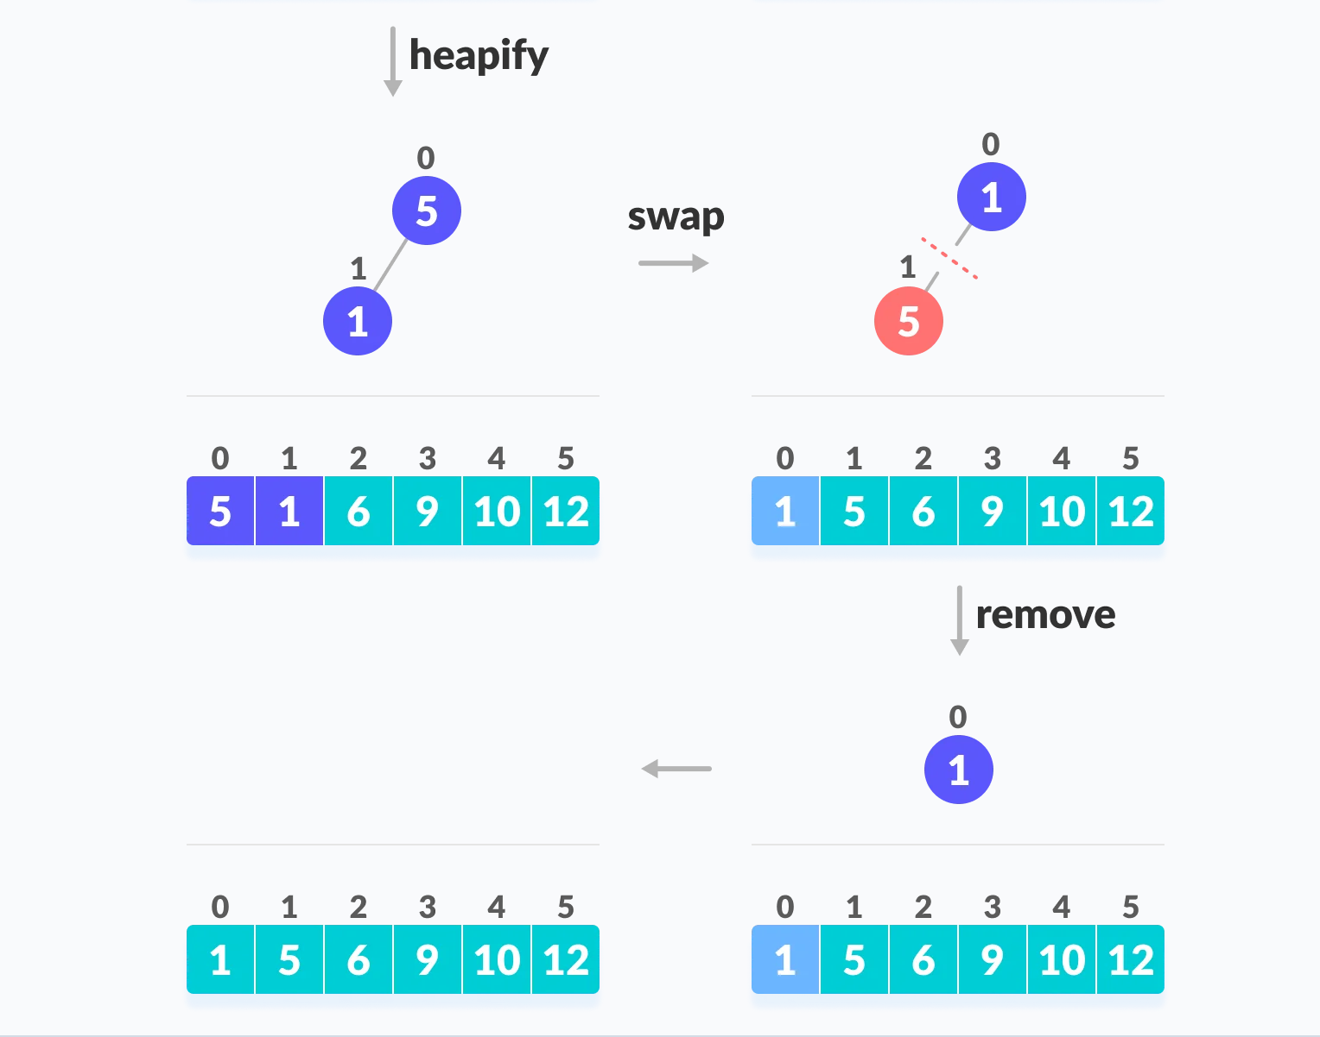
implementation

Slide 13
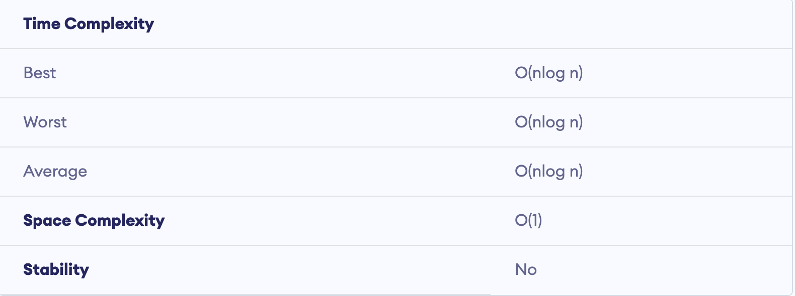
properties

Slide 14
Properties
Systems concerned with security and embedded systems such as Linux Kernel use Heap Sort because of the O(n log n) upper bound on Heapsort's running time and constant O(1) upper bound on its auxiliary storage.
Its underlying data structure, heap, can be efficiently used if we want to extract the smallest (or largest) from the list of items without the overhead of keeping the remaining items in the sorted order. For e.g Priority Queues.

Slide 15
QUESTIONS??

